Slide 1
19
Short-Term Finance and Planning

Slide 2

Chapter 19 – Index of Sample Problems
Slide # 02 - 03 Sources and uses of cash
Slide # 04 - 08 Operating and cash cycles
Slide # 09 - 10 Receivables schedule
Slide # 11 - 12 Payables schedule
Slide # 13 - 14 Disbursements schedule
Slide # 15 - 16 Net cash inflow
Slide # 17 - 18 Cumulative surplus
Slide # 19 - 20 Short-term financial plan
Slide # 21 - 22 Compensating balance
Slide # 23 - 24 Cost of factoring
Slide # 25 - 28 Collections

Slide 3
2: Sources and uses of cash
Account | Beginning Balance | Ending Balance | Source of Cash | Use of Cash
Cash | 444 | 460 |  | U
Accounts receivable | 996 | 980
Inventory | 1,387 | 1,405
Fixed assets | 4,813 | 5,209
Accounts payable | 1,042 | 1,234
Note payable | 250 | 500
Long-term debt | 1,500 | 1,200
Common stock | 2,900 | 3,000 | S
Retained earnings | 1,948 | 2,120

Slide 4
3: Sources and uses of cash
Account | Beginning Balance | Ending Balance | Source of Cash | Use of Cash
Cash | 444 | 460 |  | U
Accounts receivable | 996 | 980 | S
Inventory | 1,387 | 1,405 |  | U
Fixed assets | 4,813 | 5,209 |  | U
Accounts payable | 1,042 | 1,234 | S
Note payable | 250 | 500 | S
Long-term debt | 1,500 | 1,200 |  | U
Common stock | 2,900 | 3,000 | S
Retained earnings | 1,948 | 2,120 | S

Slide 5
4: Operating and cash cycles
Average accounts receivable | $ 2,080
Average inventory | 2,400
Average accounts payable | 1,135
Sales | 15,600
Cost of goods sold | 9,761
Given the information in the table, compute the operating and cash cycles.

Slide 6
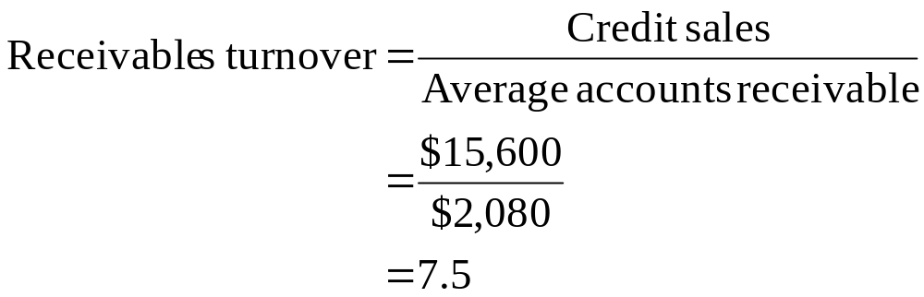
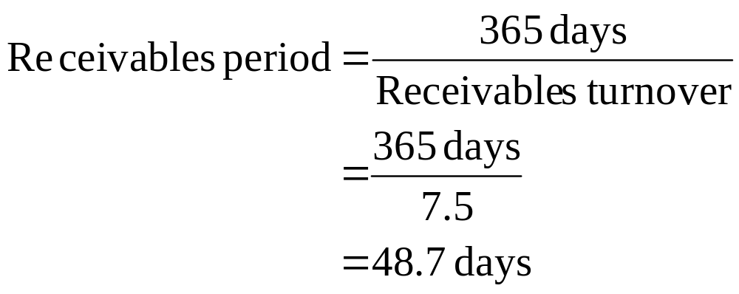
5: Operating and cash cycles

Slide 7
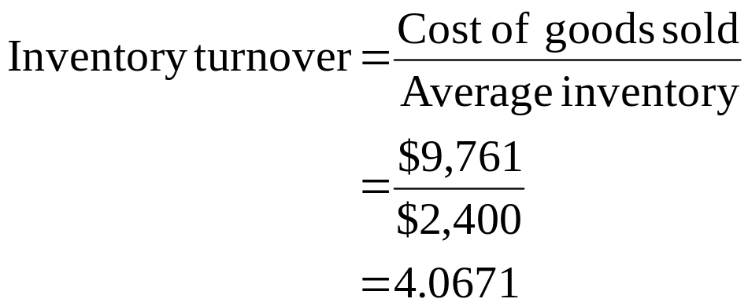
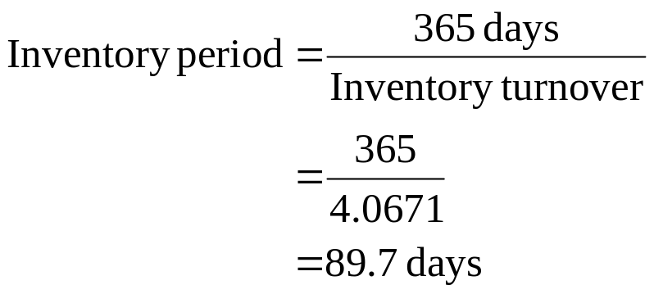
6: Operating and cash cycles

Slide 8
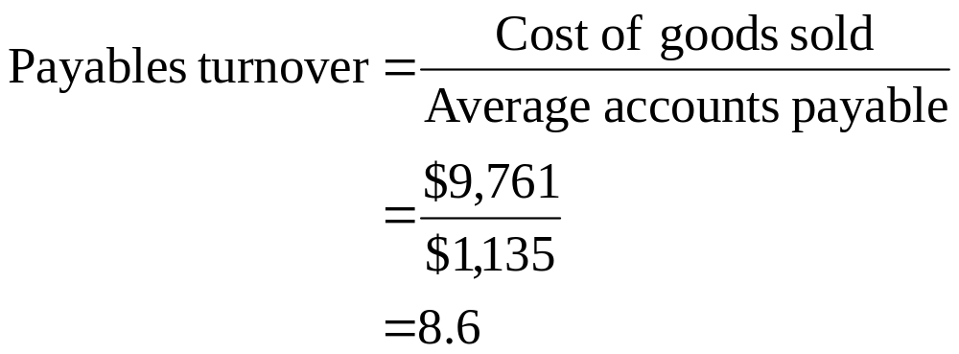
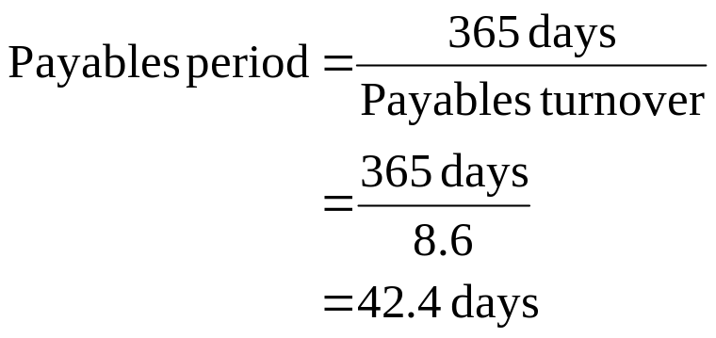
7: Operating and cash cycles

Slide 9
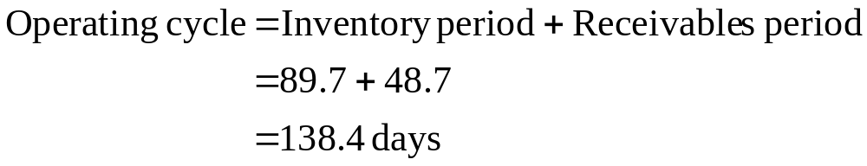

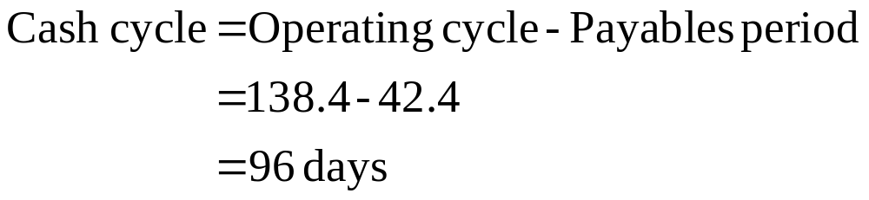
8: Operating and cash cycles

Slide 10
9: Receivables schedule
 | Q1 | Q2 | Q3 | Q4
Beginning receivables | 290
Sales | 300 | 270 | 360 | 420
Cash collections
Ending receivables
The receivables period is 60 days.
Assume that each month has 30 days.
Can you complete this table?

Slide 11
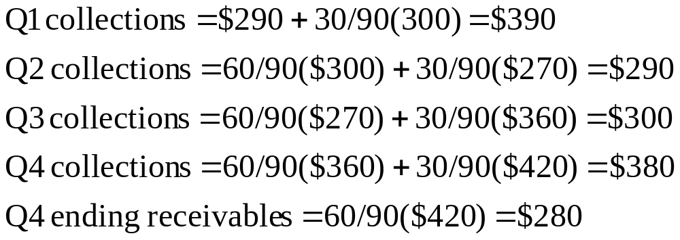
10: Receivables schedule
 | Q1 | Q2 | Q3 | Q4
Beginning receivables | 290 | 200 | 180 | 240
Sales | 300 | 270 | 360 | 420
Cash collections | 390 | 290 | 300 | 380
Ending receivables | 200 | 180 | 240 | 280

Slide 12
11: Payables schedule
 | Q1 | Q2 | Q3 | Q4
Sales | 300 | 270 | 360 | 420
Beginning payables | 90
Purchases
Payments | 171
Ending payables
Sales for Q1 of the following year are $310.
Purchases are equal to 60% of the next quarter sales.
The payables period is 45 days.
Assume that each month has 30 days.

Slide 13
12: Payables schedule
 | Q1 | Q2 | Q3 | Q4
Sales | 300 | 270 | 360 | 420
Beginning payables | 90 | 81 | 108 | 126
Purchases | 162 | 216 | 252 | 186
Payments | 171 | 189 | 234 | 219
Ending payables | 81 | 108 | 126 | 93
Q1 purchases = .6($270) = $162
Q2 purchases = .6($360) = $216
Q3 purchases = .6($420) = $252
Q4 purchases = .6($310) = $186
Sales for Q1 next year = $310
Q1 payments = $90 + 45/90($162) = $171
Q2 payments = 45/90($162)+ 45/90($216) = $189
Q3 payments = 45/90($216) + 45/90($252) = $234
Q4 payments = 45/90($252) + 45/90($186) = $219

Slide 14
13: Disbursements schedule
 | Q1 | Q2 | Q3 | Q4
Payment of accounts | 171 | 189 | 234 | 219
Wages, taxes, other expenses | 70 | 85 | 90 | 110
Capital expenditures |  | 80 | 35
Long-term financing expenses | 12 | 12 | 12 | 12
Total cash disbursements

Slide 15
14: Disbursements schedule
 | Q1 | Q2 | Q3 | Q4
Payment of accounts | 171 | 189 | 234 | 219
Wages, taxes, other expenses | 70 | 85 | 90 | 110
Capital expenditures |  | 80 | 35
Long-term financing expenses | 12 | 12 | 12 | 12
Total cash disbursements | 253 | 366 | 371 | 341

Slide 16
15: Net cash inflow
 | Q1 | Q2 | Q3 | Q4
Collections | 390 | 290 | 300 | 380
Disbursements | 253 | 366 | 371 | 341
Net cash inflow
What is the net cash inflow for each quarter?

Slide 17
16: Net cash inflow
 | Q1 | Q2 | Q3 | Q4
Collections | 390 | 290 | 300 | 380
Disbursements | 253 | 366 | 371 | 341
Net cash inflow | 137 | -76 | -71 | 39

Slide 18
17: Cumulative surplus
 | Q1 | Q2 | Q3 | Q4
Beginning cash balance | 20
Net cash inflow | 137 | -76 | -71 | 39
Ending cash balance
Minimum cash balance | -20
Cumulative surplus (deficit)
Can you complete this table?

Slide 19
18: Cumulative surplus
 | Q1 | Q2 | Q3 | Q4
Beginning cash balance | 20 | 157 | 81 | 10
Net cash inflow | 137 | -76 | -71 | 39
Ending cash balance | 157 | 81 | 10 | 49
Minimum cash balance | -20 | -20 | -20 | -20
Cumulative surplus (deficit) | 137 | 61 | -10 | 29
In which quarters does the firm have surplus funds?
In which quarter does the firm need to borrow funds?

Slide 20
19: Short-term financial plan
Assume amounts are in thousands | Q1 | Q2 | Q3 | Q4
Beginning cash balance | 20.0
Net cash inflow | 137.0 | -76.0 | -71.0 | 39.0
New short-term borrowing | ---
Interest 12% annual rate | -.9
Short-term borrowing repaid | -30.0
Ending cash balance
Minimum cash balance | -20.0 | -20.0 | -20.0 | -20.0
Cumulative surplus (deficit)
Beginning short-term borrowing | 30.0
Change in short-term debt
Ending short-term debt

Slide 21
20: Short-term financial plan
 | Q1 | Q2 | Q3 | Q4
Beginning cash balance | 20.0 | 126.1 | 50.1 | 20.0
Net cash inflow | 137.0 | -76.0 | -71.0 | 39.0
New short-term borrowing | --- | --- | 40.9 | ---
Interest on short-term borrowing | -.9 | --- | --- | -1.2
Short-term borrowing repaid | -30.0 | --- | --- | -37.8
Ending cash balance | 126.1 | 50.1 | 20.0 | 20.0
Minimum cash balance | -20.0 | -20.0 | -20.0 | -20.0
Cumulative surplus (deficit) | 106.1 | 30.1 | 0.0 | 0.0
Beginning short-term borrowing | 30.0 | 0.0 | 0.0 | 40.9
Change in short-term debt | -30.0 | 0.0 | 40.9 | -37.8
Ending short-term debt | 0.0 | 0.0 | 40.9 | 3.1

Slide 22
21: Compensating balance
You have a $50,000 line of credit with your local bank to cover your quarterly cash needs. The loan terms have a 5% compensating balance requirement.
How much will you have to borrow if you need to net $20,900?
What is the effective interest rate of the loan if the stated rate is 8% and the loan is for one year?

Slide 23
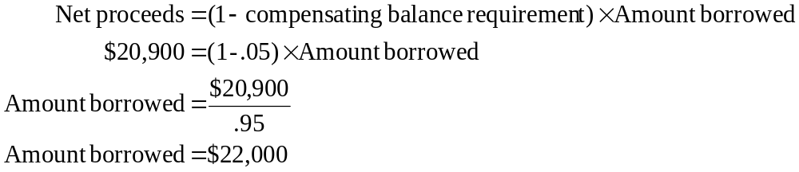
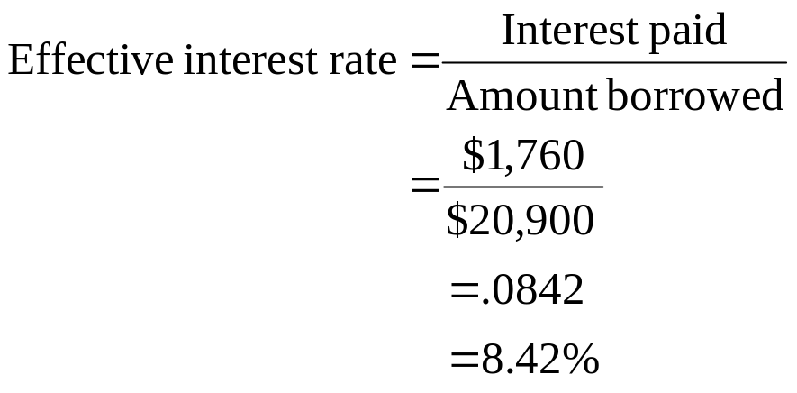
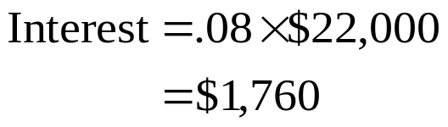
22: Compensating balance

Slide 24
23: Cost of factoring
Your firm has average receivables of $990 and a 60 day receivables period. You factor your receivables at a rate of 2.5%.
What is the effective annual rate of your factoring program?

Slide 25
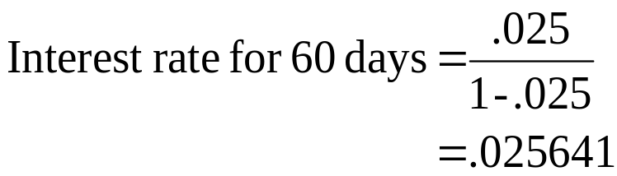
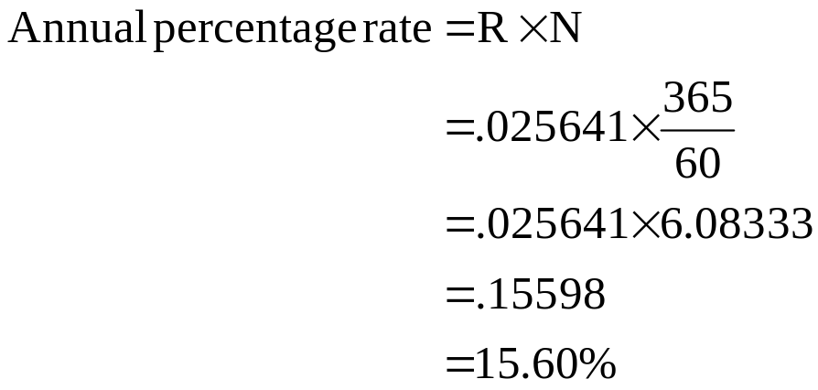
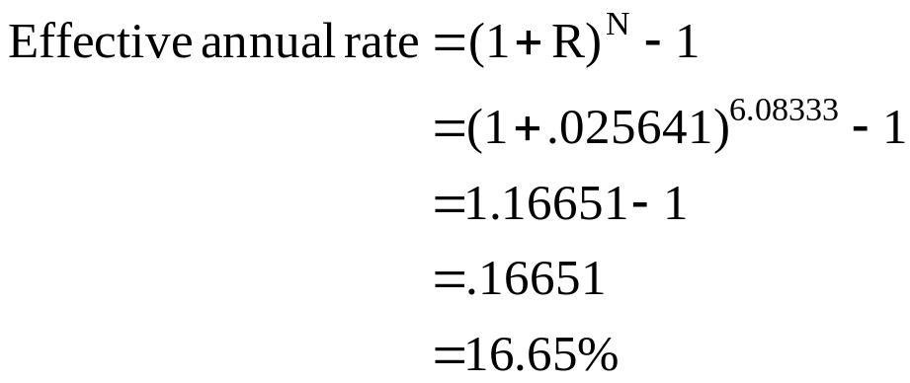
24: Cost of factoring

Slide 26
25: Collections
Your projected sales are:
Jan $800
Feb $720
Mar $940
You collect 50% in the month of sale, 40% in the month following the month of sale and 8% in the second month following the month of sale.
What is the amount of your March collections?

Slide 27
26: Collections
March collections:
50% of March sales: .50 × $940 = $470
40% of February sales: .40 × $720 = $288
8% of January sales: .08 × $800 = $ 64
Total: $822

Slide 28
27: Collections
Your projected sales are:
Q1 $900
Q2 $880
Q3 $970
Your receivables period is 38 days.
Assume every quarter has 90 days.
Assume sales occur evenly throughout the quarter.
What is the amount of your Q2 collections?

Slide 29
28: Collections
Q2 collections:
From prior quarter: (38/90) × $900 = $380
From current quarter: (90 - 38)/90 × $880 = $508
Total: $888

Slide 30
19
End of Chapter 19

